Slide 1

Intelligent intrusion detection system using enhanced deep neural networks
Jntuh university college of engineering
Department of computer science and engineering
Team supervisor/guide:
Presentation by:
n.t.Varshith sagar (21011M2105)
p.Praharsh (21011M2113)
p.Thanu reddy (21011M2209)
Dr.K.Shahu Chatrapati
Professor & Addl. Controller of Examinations (on deputation at JNTUH- HYDERABAD)

Slide 2

Table of contents
1.Introduction
2.Project Abstract
3.Existing Model
4.Proposed Solution
5.Algorithms Used
6.Dataset and Libraries Used
7.Implementation Plan
8.Expected Outcome
9.Conclusion

Slide 3
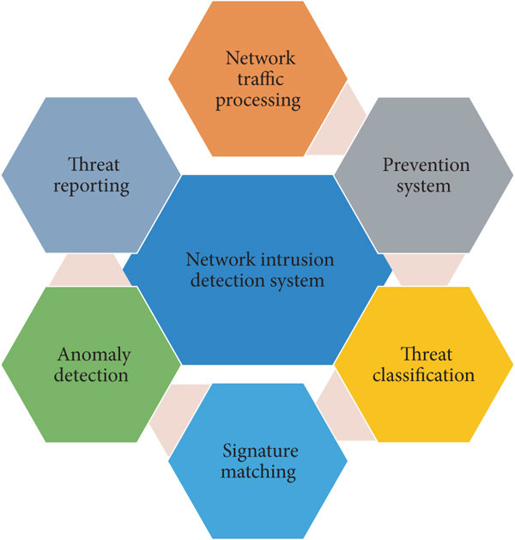
Introduction
ICT systems and networks use data from users to prevent attacks, which can be manual or machine-generated. As cyberattacks evolve, so do security risks. Intrusion detection systems (IDS) are proactive methods to detect and classify intrusions, attacks, and security policy violations in real time.
Intrusion detection systems can be categorized into network-based intrusion detection systems (NIDS) and host-based intrusion detection systems (HIDS). Both types help protect against known attack sources.
Different applications of intrusion detection systems:
1.Network traffic processing
2.Prevention system
3.Threat classification
4.Signature matching
5.Anomaly detection
6.Threat reporting

Slide 4
PROJECT Abstract
As cyberattacks become more sophisticated, the need for advanced security measures continues to grow. This project focuses on improving Intrusion Detection Systems (IDS) to better identify and prevent network intrusions. By utilizing machine learning techniques and analyzing network traffic data, the project aims to develop an efficient and scalable system capable of detecting both known and unknown threats in real-time. The proposed system will be tested using benchmark datasets and evaluated based on performance metrics such as accuracy, precision, and recall.
Key challenges addressed include minimizing false positives and adapting to novel attack patterns. The system leverages deep learning to process large datasets and detect subtle anomalies that traditional methods might miss. Additionally, the project emphasizes the importance of real-time monitoring to ensure prompt responses to potential threats. This approach will contribute to enhancing overall network security and resilience against evolving cyber threats.

Slide 5

EXISTING MODEL
Older versions of Intelligent Intrusion Detection Systems (IDS) using enhanced neural networks face several challenges. They often lack scalability, struggling to efficiently manage large-scale networks and high traffic volumes. Additionally, these systems have difficulty detecting novel or zero-day attacks, as they rely heavily on predefined rules and patterns, making them less adaptable to emerging threats. High false positive rates are also common, overwhelming administrators with unnecessary alerts. Moreover, slow detection and response times leave networks vulnerable to real-time attacks, while encrypted traffic often goes unanalyzed, reducing their effectiveness. Lastly, these systems are resource-intensive, requiring significant computational power, which can lead to performance bottlenecks and increased costs.

Slide 6
Proposed solution
The proposed solution integrates Deep Neural Networks (DNN), Random Forest, and Support Vector Machine (SVM) to enhance Intrusion Detection System (IDS) capabilities. These algorithms are applied to the NSL-KDD dataset, ensuring comprehensive testing for effective cyber-attack detection, with performance evaluated using accuracy, precision, recall, and F1-score. The project also introduces the Scale-Hybrid-IDS-AlertNet (SHIA) framework, which combines deep learning and traditional machine learning for real-time monitoring and proactive alerts. This approach improves anomaly detection, reduces false positives, and provides robust protection against emerging cyber threats.

Slide 7
Algorithms used
Support Vector Machine (SVM)
SVM is a popular supervised learning algorithm used mainly for classification. It creates the optimal hyperplane that separates different classes in n-dimensional space. The hyperplane is determined by the extreme points called support vectors, which are crucial for accurate classification.
Random Forest
Random Forest is an ensemble learning method that combines multiple decision trees to enhance classification and regression tasks. By averaging the predictions of numerous trees, it improves accuracy and reduces overfitting. Each tree in the forest votes on the final prediction, leading to robust and reliable outcomes.
Deep Neural Network (DNN)
DNNs, or deep nets, are neural networks with multiple layers that process data through complex mathematical models. They excel in handling large datasets and improving accuracy in classification tasks. DNNs, also known as Feed Forward Neural Networks (FFNNs), only process data in the forward direction and require substantial data for effective training.

Slide 8
Dataset and libraries used
The NSL-KDD data set is a well-known benchmark in the research of Intrusion Detection techniques A lot of work is going on for the improvement of intrusion detection strategies while the research on the data used for training and testing the detection model is equally of prime concern because better data quality can improve offline intrusion detection.
TensorFlow is an end-to-end open-source platform for machine learning. It has a comprehensive, flexible ecosystem of tools, libraries, and community resources that lets researchers push the state-of-the-art in ML and gives developers the ability to easily build and deploy ML-powered applications.
Keras runs on top of open-source machine libraries like TensorFlow, Theano, or Cognitive Toolkit (CNTK). Theano is a Python library used for fast numerical computation tasks. CNTK is a deep learning framework developed by Microsoft. It uses libraries such as Python, C#, C++, or standalone machine learning toolkits.

Slide 9
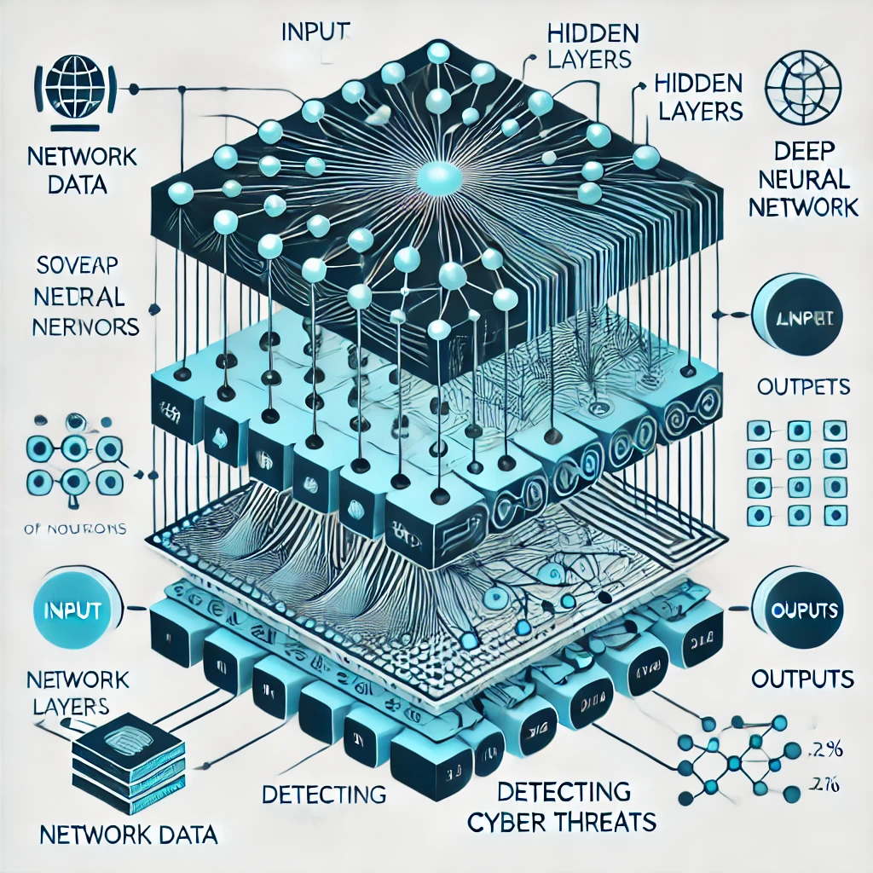
IMPLEMENTATION PLAN
The System Design Document describes the system requirements, operating environment, system and subsystem architecture, files, and database design, input formats, output layouts, human-machine interfaces, detailed design, processing logic, and external interfaces. This application has six modules which are listed in the following.
Upload NSL-KDD dataset
Pre-process dataset
A Generate training model
Support Vector Machine Algorithm
Random Forest Algorithm
Deep Neural Network Algorithm

Slide 10
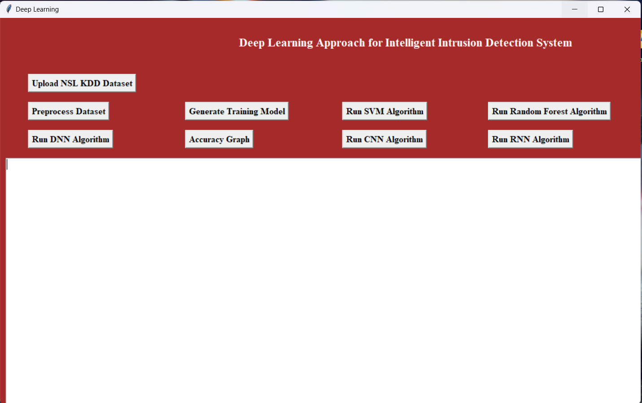
EXPECTED OUTCOME

Slide 11
DNN ACCURACY
SVM ACCURACY
RANDOM FOREST ACCURACY

Slide 12
Conclusion
We proposed a hybrid intrusion detection alert system using a highly scalable framework on commodity hardware server which has the capability to analyze the network and host-level activities. The framework employed distributed deep learning model with DNNs for handling and analyzing very large scale data in real time. The DNN model was chosen by comprehensively evaluating their performance in comparison to classical machine learning classifiers on various benchmark IDS datasets. In addition, we collected host-based and network-based features in real-time and employed the proposed DNN model for detecting attacks and intrusions

Slide 13
THANK YOU
ANY QUESTIONS?

